Slide 1
SC1015 Mini Project
Students Performance In Exams
SC7 Team 7: Yao Xian(Robin), Akash, John

Slide 2
Problem Formulation
Does parental education really affect student results?
Does attending Test Prep Course affect student results?
Does having a proper lunch affects performance?
Does doing good in one subject mean they are good in another subject?

Slide 3
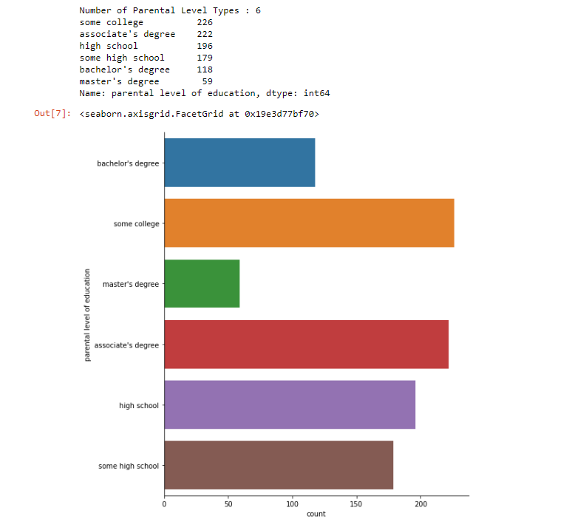
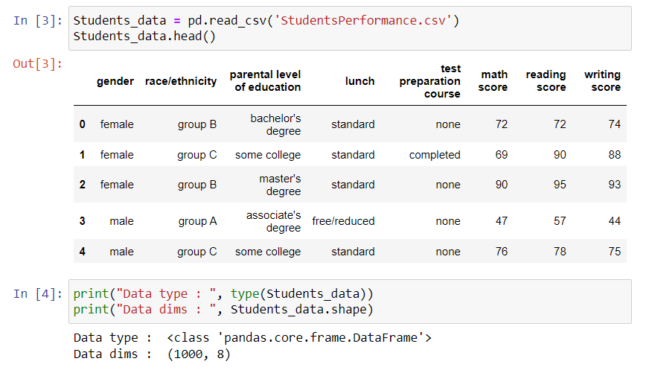
Data Introduction

Slide 4
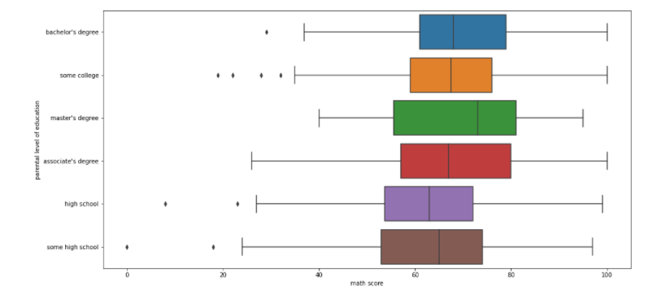
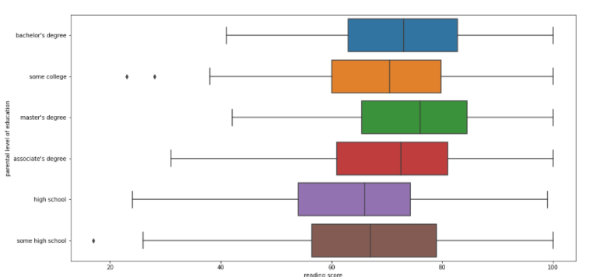
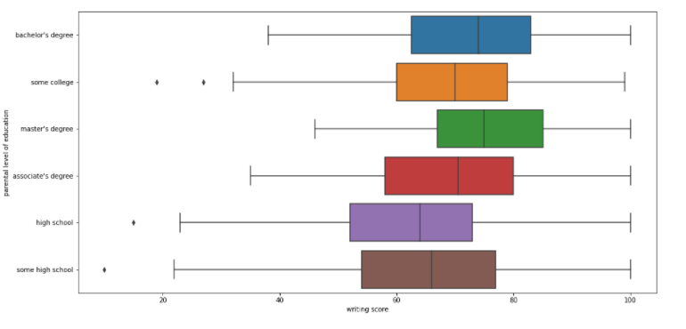
Data Introduction

Slide 5
RFC VS SVM Vs Naive Bayes?
1
Done By: AKASH

Slide 6
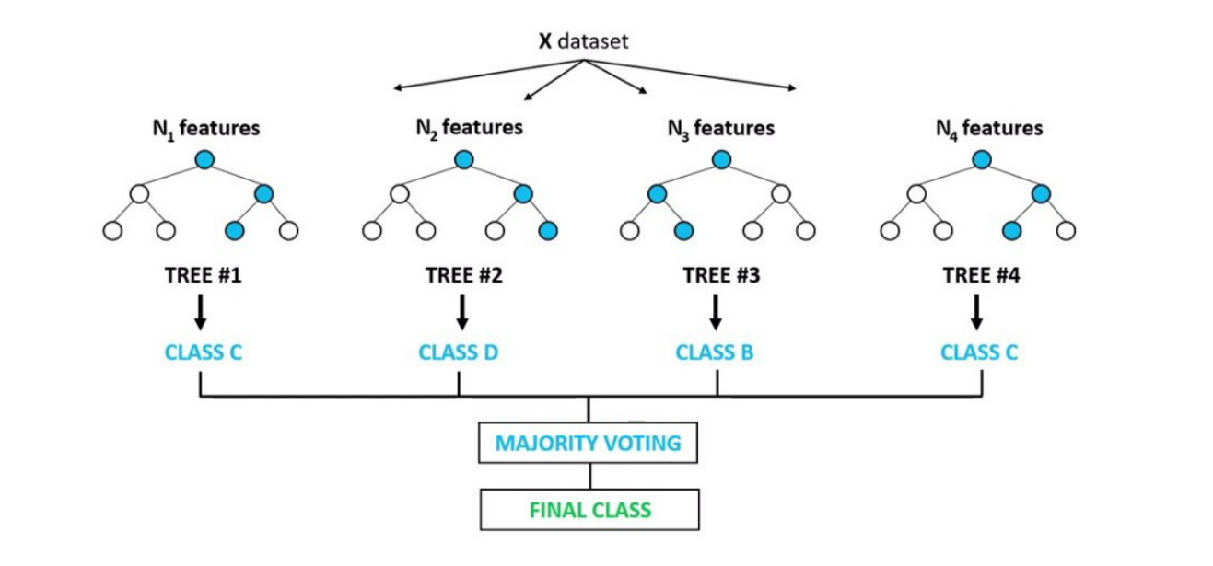
Random Forest Classifier
Random Forest is a supervised learning algorithm
Consists a large number of decision trees that operate as an ensemble
Each Individual tree in the random forest spits out a class prediction
The class with the most votes becomes our model prediction
Fits a number of decision tree classifiers on various sub-samples of the dataset and uses averaging to improve the predictive accuracy and control over-fitting
The model is generally trained using a bagging method

Slide 7
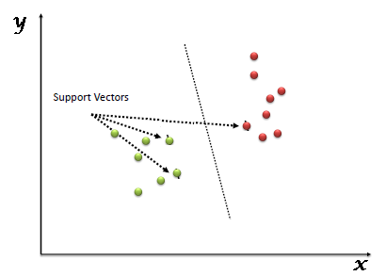
SUPPORT VECTOR MACHINE
Is a supervised machine learning algorithm
We plot each data item as a point in n-dimensional space with the value of each feature being the value of a particular coordinate.
Then, we perform classification by finding the hyper-plane that differentiates the two classes very well .

Slide 8
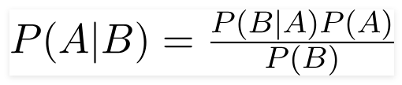
GAUSSIAN NAIVE BAYES
Uses various features to discriminate different objects
Using Bayes theorem, we can find the probability of A happening, given that B has occurred.
Here, B is the evidence and A is the hypothesis. The assumption made here is that the predictors/features are independent. That is presence of one particular feature does not affect the other.
Hence it is called naive.
3 Types of Naive Bayes Classifier : Multinomial , Bernoulli & Gaussian

Slide 9
Does parental education really affect student results?
2
Done By: Yao Xian(Robin)

Slide 10
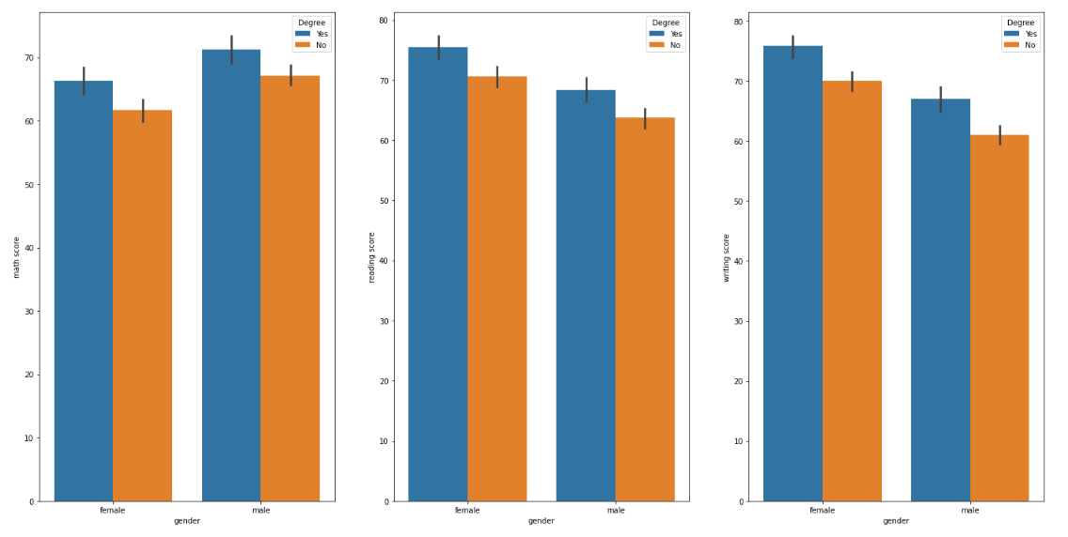
Data Analysis

Slide 11
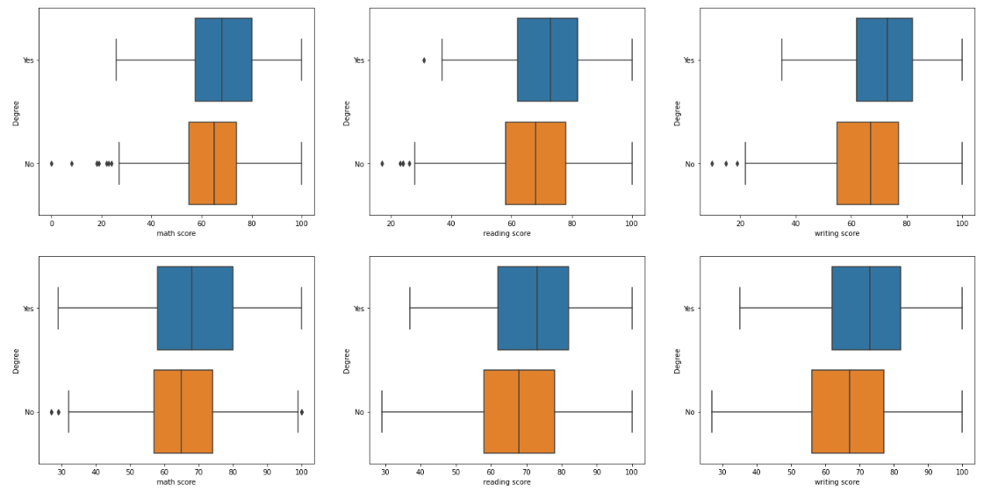
Data Analysis

Slide 12
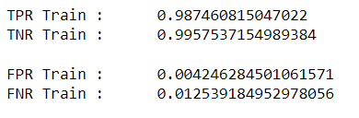
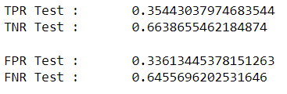
Data Analysis (Random Forest Classification)
Train Set
Test Set

Slide 13
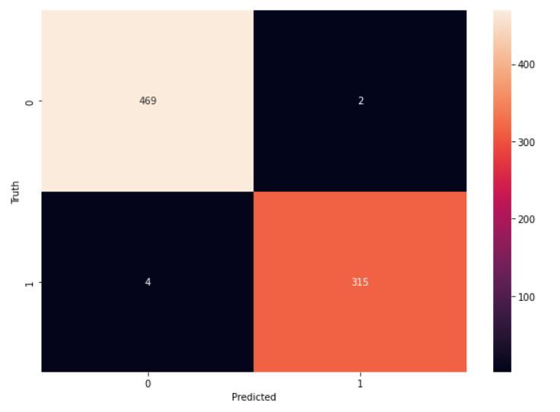
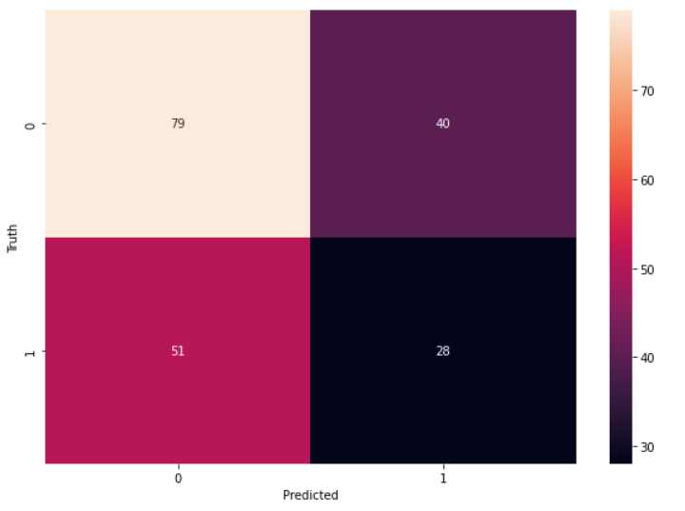
Data Analysis (Random Forest Classification)
Train Set
Test Set

Slide 14
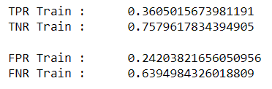
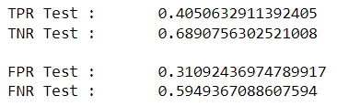
Data Analysis (Naive Bayes)
Train Set
Test Set

Slide 15
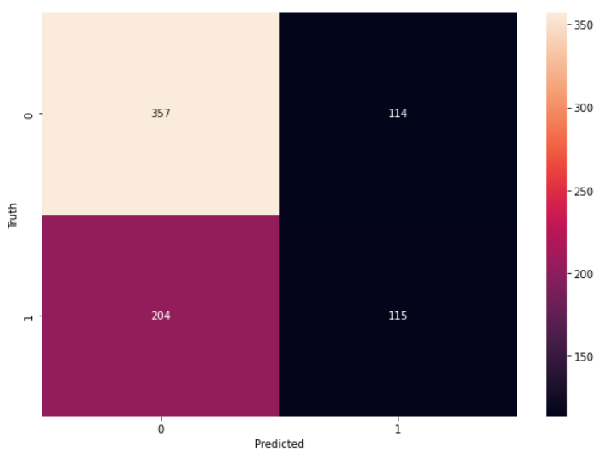
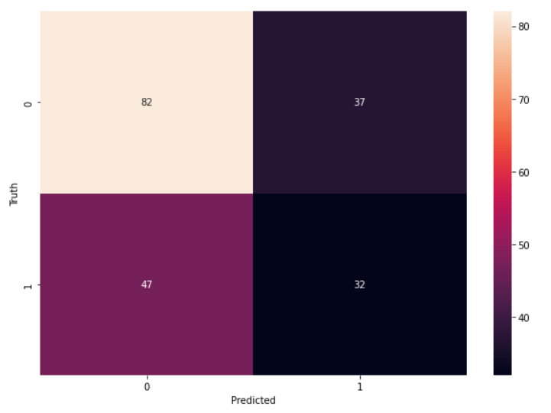
Data Analysis (Naive Bayes)
Train Set
Test Set

Slide 16
Does Test Prep Course really affect student results?
3
Done By: Yao Xian(Robin)

Slide 17
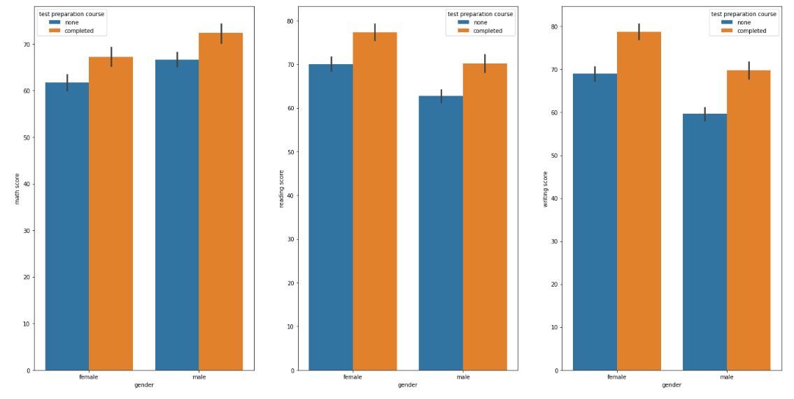
Data Analysis

Slide 18
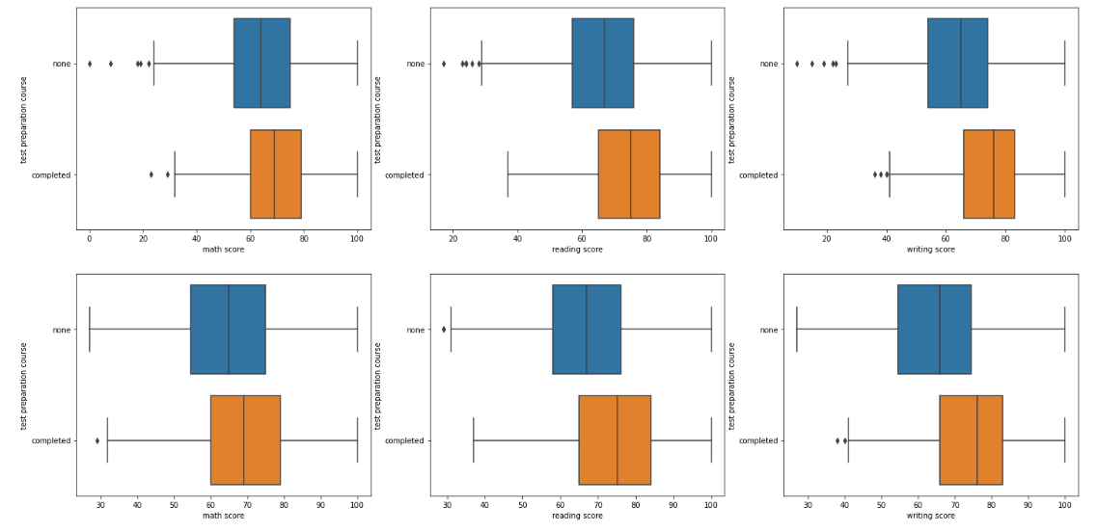
Data Analysis

Slide 19
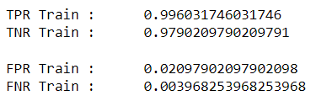
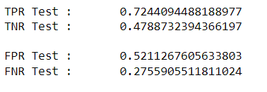
Data Analysis (Random Forest Classification)
Train Set
Test Set

Slide 20
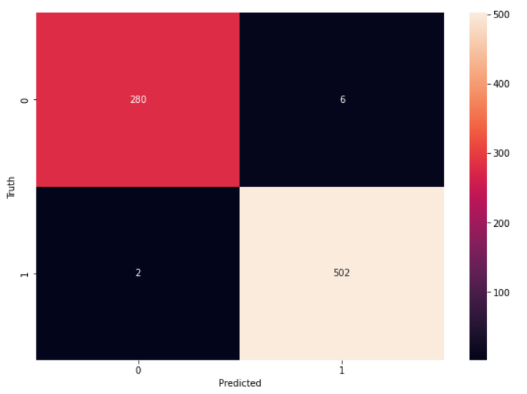
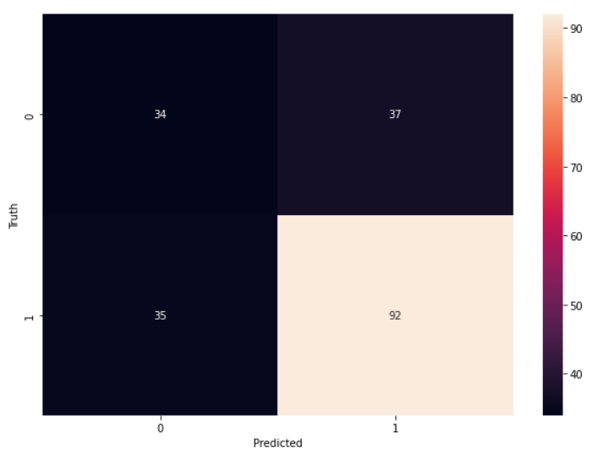
Data Analysis (Random Forest Classification)
Train Set
Test Set

Slide 21
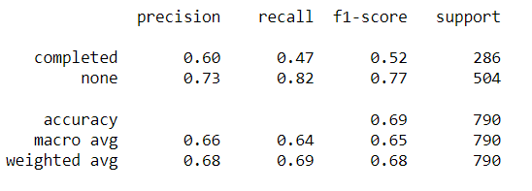
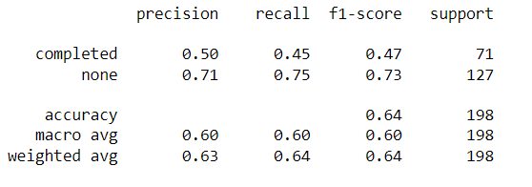
Data Analysis (Support Vector Machine)
Test Set
Train Set

Slide 22
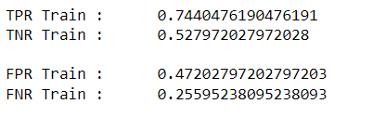
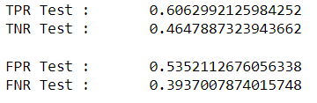
Data Analysis (Naive Bayes)
Train Set
Test Set

Slide 23
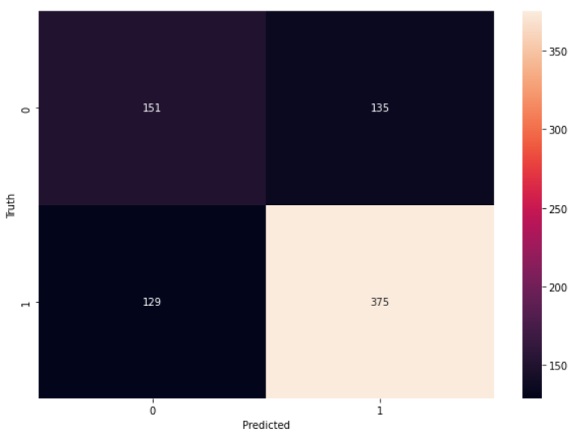
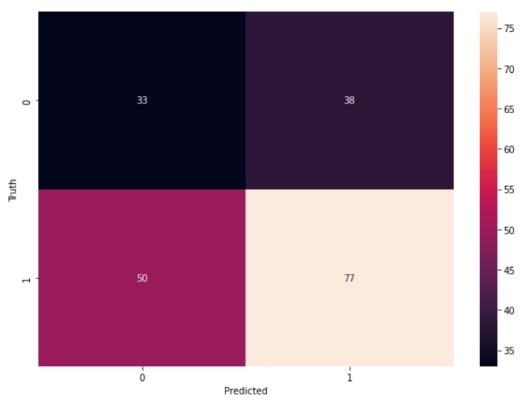
Data Analysis (Naive Bayes)
Train Set
Test Set

Slide 24
Does having a proper lunch affects performance?
4
Done By: Yao Xian(Robin)

Slide 25
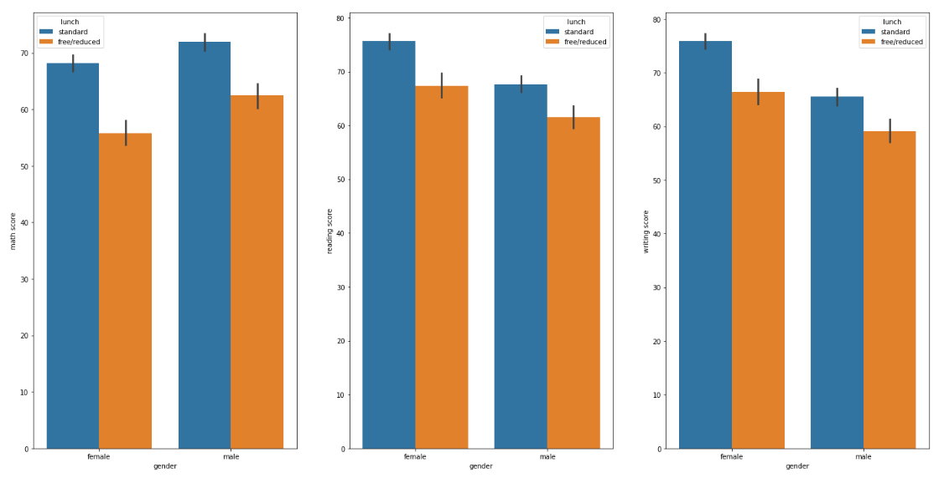
Data Analysis

Slide 26
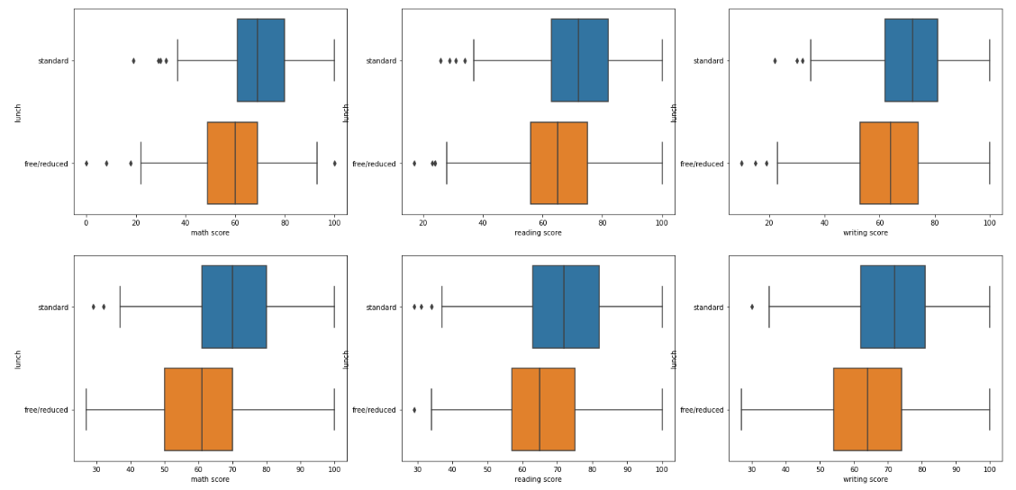
Data Analysis

Slide 27
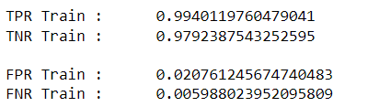
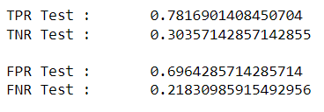
Data Analysis (Random Forest Classification)
Train Set
Test Set

Slide 28
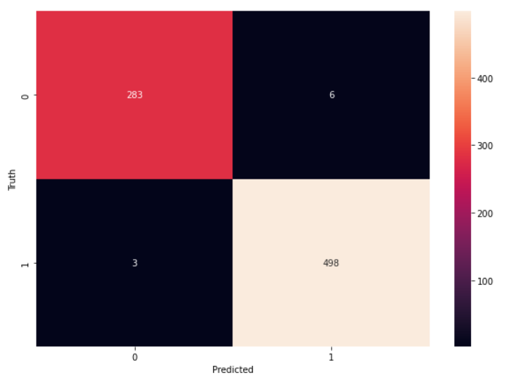
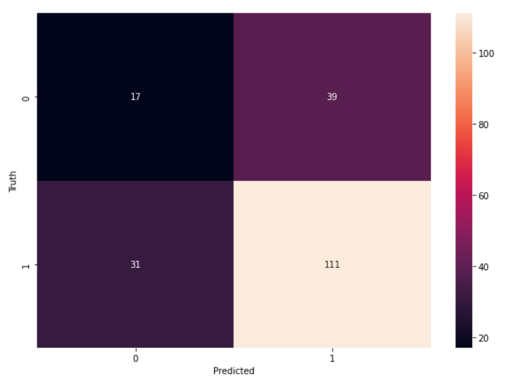
Data Analysis (Random Forest Classification)
Train Set
Test Set

Slide 29
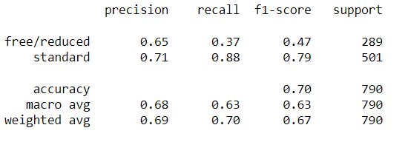
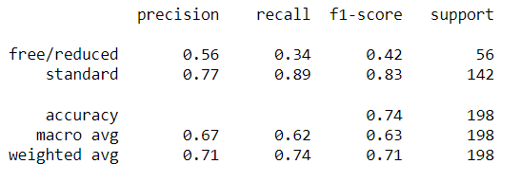
Data Analysis (Support Vector Machine)
Test Set
Train Set

Slide 30
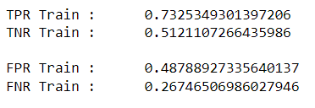
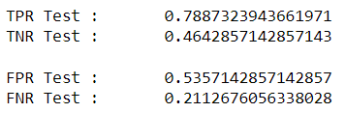
Data Analysis (Naive Bayes)
Train Set
Test Set

Slide 31
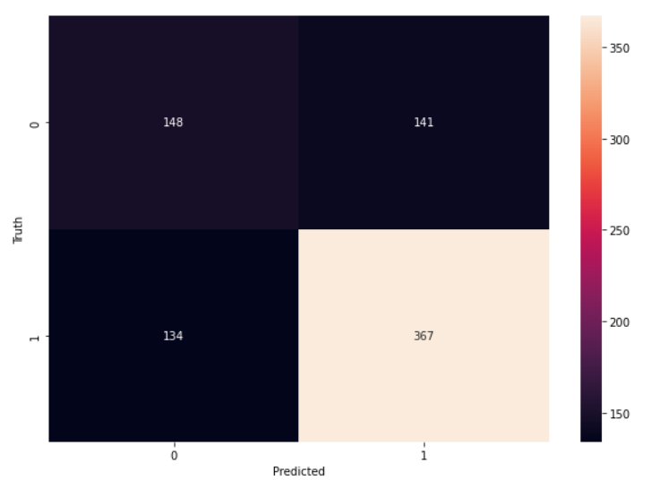
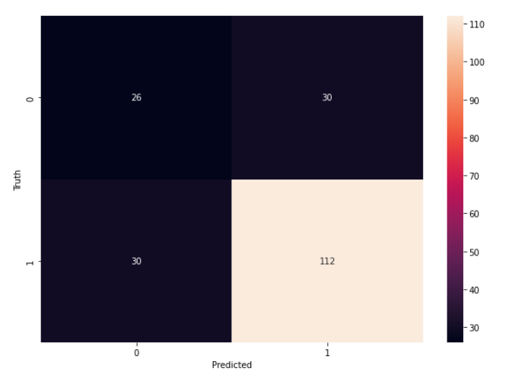
Data Analysis (Naive Bayes)
Train Set
Test Set

Slide 32
Does doing good in one subject mean they are good in another?
5
Done by: John

Slide 33
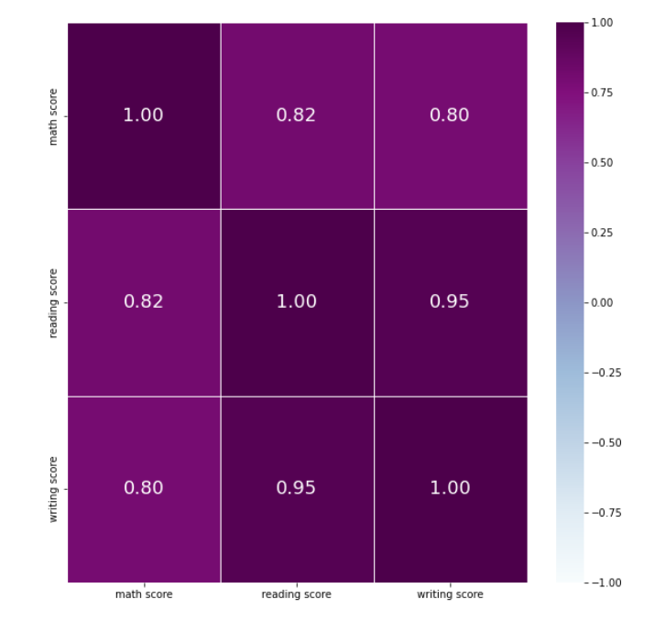
Correlation of the different scores

Slide 34
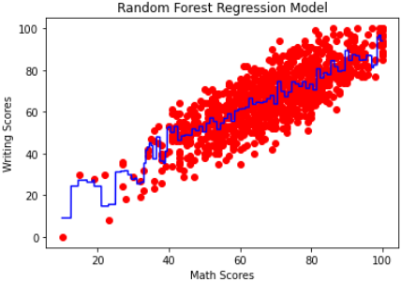
Using Writing score VS predict Math score
(Random Forest Regression)
MAE | 7.29
RMSE | 8.92
R^2 | 0.69

Slide 35
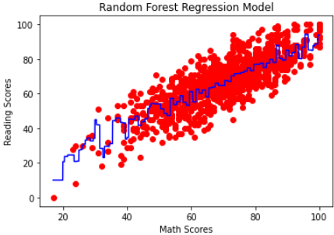
Using Reading score VS predict Math score
(Random Forest Regression)
MAE | 7.24
RMSE | 9.09
R^2 | 0.65

Slide 36
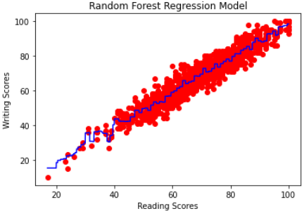
Using Writing score VS predict Reading score
(Random Forest Regression)
MAE | 3.63
RMSE | 4.54
R^2 | 0.91

Slide 37
Conclusion
6
Done by: John

Slide 38



CONCLUSION
Parents Holding Degree
Test Preparation Course
A+
Proper Lunch
A+

Slide 39
THANK YOU!

